Slide 1

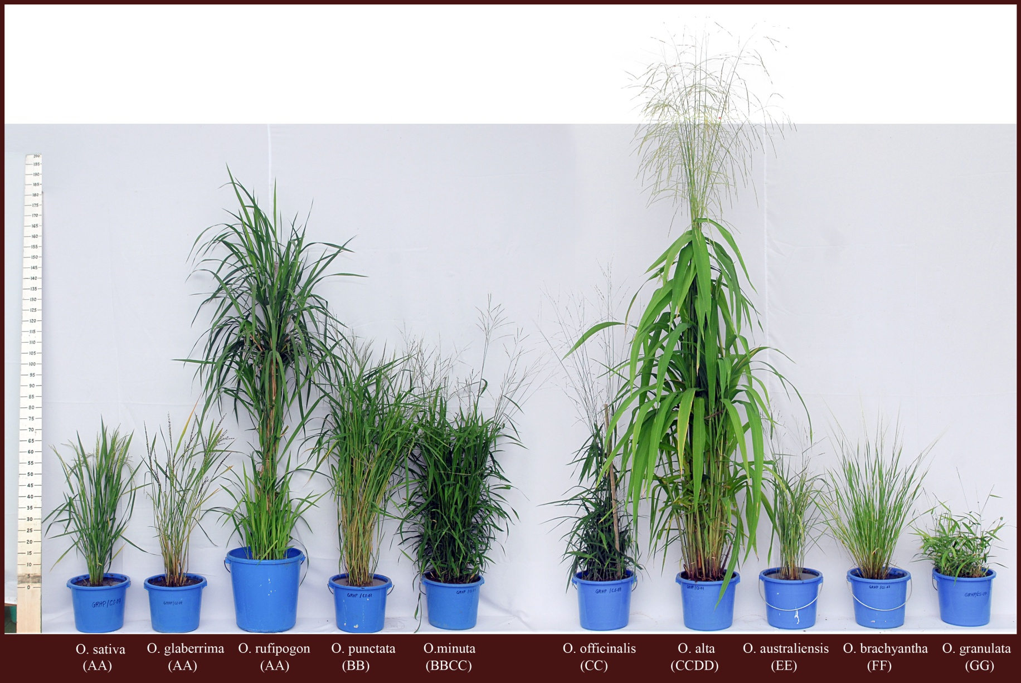
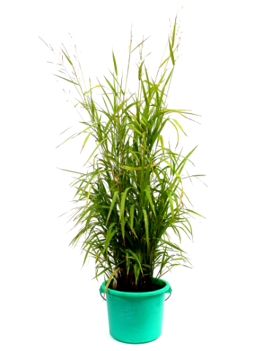
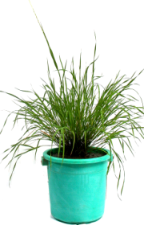


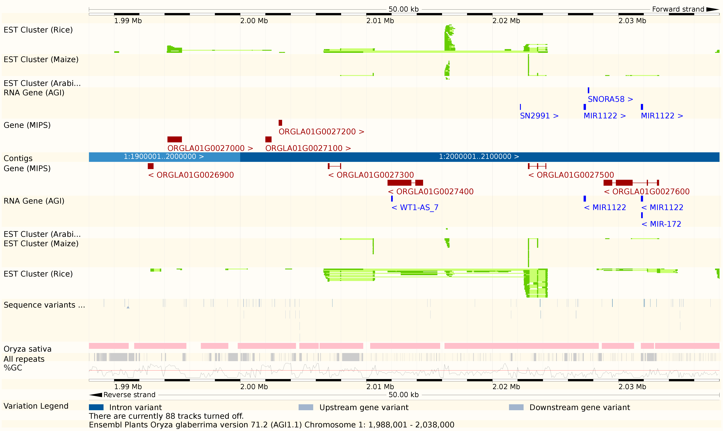
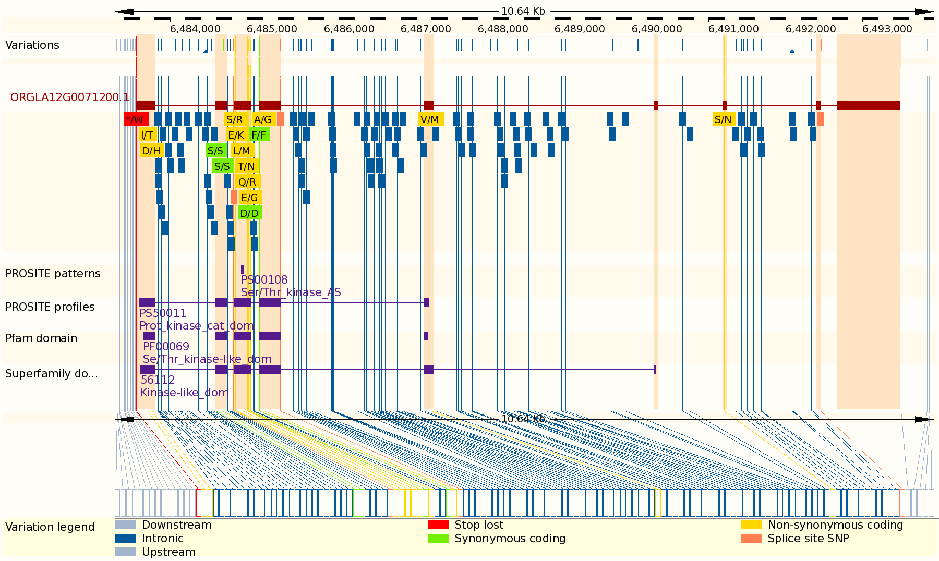
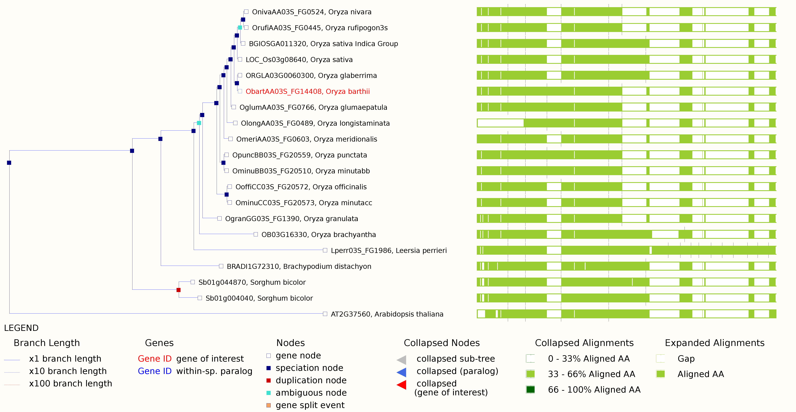
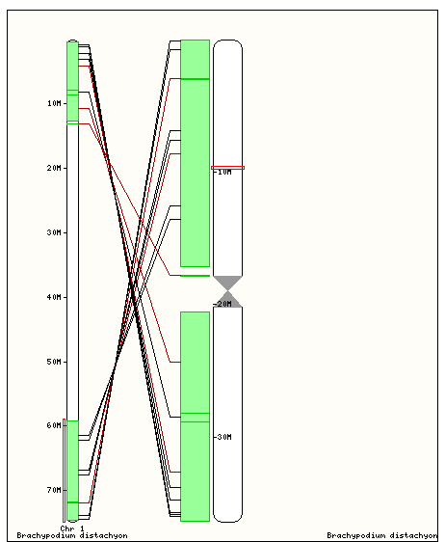
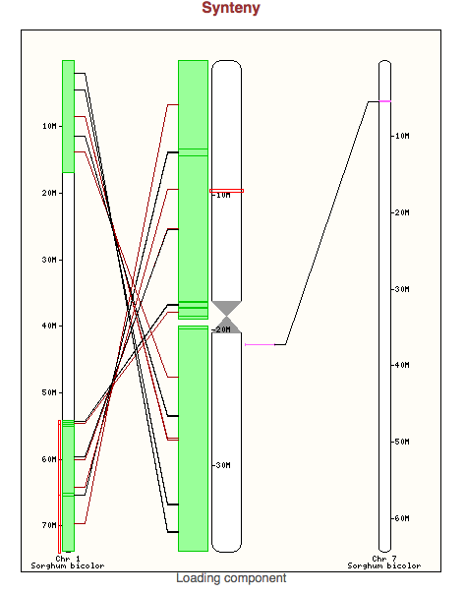
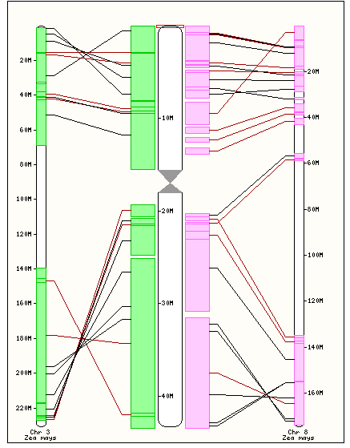





Gramene: aN integrated phylogenomics resource
for the Oryza genus
Sharon Wei¹, Joshua C Stein¹, William Spooner¹, Yu Yeisoo², Dario Copetti², David Kudrna², Jianwei Zhang², Steven Rounsley³, Jose Luis Goicoechea², Kapeel Chougule², Xiang Song², Manyuan Long⁴, Michael Sanderson⁵, Carlos A Machado⁶, Scott Jackson⁷, Mingsheng Chen⁸, Rod Wing², Ware Doreen^{1,9}
¹Cold Spring Harbor Laboratory, Cold Spring Harbor, NY, 11724, ²University of Arizona, Arizona Genomics Institute, Tucson, AZ, 85705, ³Dow Agrosciences, Indianapolis, IN, 46268 ,
⁴ University of Chicago, Department of Ecology and Evolution, Chicago, IL, 60637, ⁵University of Arizona, Department of Ecology and Evolution, Tuscon, AZ, 85721,
⁶University of Maryland, Department of Biology, College Park, MD, 20742, ⁷University of Georgia, Center for Applied Genetic Technologies, Athens, GA, 30602,
⁸ Chinese Academy of Sciences, Beijing, China, ⁹USDA ARS
ABSTRACT: The Oryza genus is emerging as a powerful model system for studying trait-evolution, speciation and domestication. Gramene has built a genus level resource for comparative genomics in cultivated rice and its wild relatives. The web-portal includes complete reference sequences for cultivated Asian rice (O. sativa) and African rice (O. glaberrima), and the distant wild relatives O. barthii, O. brachyantha and O. punctata. It also hosts a vertical data set of chr 3 short-arm assemblies for 9 wild species that represent the broad diversity of genome types within the genus, including one polyploid: O. nivara, O. rufipogon, O. longistaminata, O. meridionalis, O. glumaepatula, O. minuta, O. officinalis, O. granulata, and Leersia perrieri (outgroup). Each is displayed in a genome browser showing gene models, repeats, and EST alignments. For some, germplasm diversity data are also available. SNP and other structural variations are displayed in the context of gene models and classified by predicted functional consequence. Ancestrally conserved regions and structural rearrangements are defined by whole genome alignments and displayed in a multi-species view that enables interspecies browser navigation. A comprehensive set of phylogenetic trees and ortholog predictions were built by the Compara GeneTree method. In addition to resolving many outstanding questions in the evolutionary history of Oryza, this resource will provide foundation for functional characterization of genes and the identification of targets for agronomic improvement of rice.
Oryza: Enormous diversity
Oryza genomes at Gramene
An untapped reservoir of genetic variation for crop improvement
23 species
2 cultivated species
10 genome types
Allotetraploids
6 complete references
- O. punctata is newest addition
13 species set chr. 3 short arms, 4
deprecated after whole genome
assemblies became available
• Projects and collaborations:
- OGE: Oryza Genome Evolution Project
- I-OMAP: International Oryza Map Alignment projects
Picture courtesy of DBrar, IRRI, The Philippines
O. sativa O. glaberrima O. rufipogon O. punctata O. minuta O. officinalis O. alta O. australiensis O. brachyantha O. granulata O. ridleyi O. coarctata
(AA) (AA) (AA) (BB) (BBCC) (CC) (CCDD) (EE) (FF) (GG) (HHJJ) (HHKK)
Tree based on Ammiraju et al. 2008. Plant Cell 20:3191
Gramene Annotation & Displays
www.gramene.org
Genome multispecies view
Annotation | chr 3 short | Complete ref
Repeat mask | ✔ | ✔
FgenesH gene prediction | ✔ | ✔
EST Alignment | ✔ | ✔
Whole genome alignment | ✔ | ✔
Phylogenetic gene trees | ✔ | ✔
InterPro |  | ✔
Data base cross reference |  | ✔
Gene Ontology |  | ✔
Community annotation |  | ✔
Pairwise whole-genome alignment to rice reference by B/LASTZ-CHAIN-NET
Cross-species browsing
Browser & SNP diversity views
Browser: example O. glaberrima (African rice)
Community annotation
RNA-seq
Variation data
Gramene analyses
Population diversity
13 O. glaberrima accessions
7 O. barthi accessions
~1 M SNPs called
Variant Effect Prediction (VEP)
Additional data from 20 O. glaberrima accessions and 19 O. barthi accessions with 8.5M SNPs is to be released in the next build
Oryza-centered gene trees
Ensembl Compara GeneTree method
15 Oryza species + Brachypodium, sorghum & Arabidopsis
18,916 gene clusters
MSA ➔ tree building
Ortholog & paralog prediction based on tree reconciliation
Synteny maps
Rice vs Brachypodium
Rice vs Sorghum
Rice vs Maize
Gene orthologs inferred from phylogenic trees
Collinear and near-collinear mappings
Interspecies browsing
Gramene is funded by the NSF award #0703908 and #1127112
The Oryza Genome Evolution (OGE) Project is funded by NSF award #1026200
The Oryza glaberrima Genome Project funded by awards to Dr. Rod Wing
The Oryza brachyantha Genome Project funded by awards to Dr. Mingsheng Chen
The Oryza Map Alignment Project received prior funding from NSF #0321678
Partial support comes from the USDA and USDA-ARS
Recent Gramene Publications:
Spooner W, et al. (2011) GrameneMart: The BioMart data portal for the Gramene project. Database (Oxford). In Press.
Jaiswal P. Gramene database: a hub for comparative plant genomics. Methods Mol Biol, 678:247-75.
Youens-Clark K, et al. (2010) Gramene database in 2010: updates and extensions. Nucleic Acids Research, 39 (suppl 1): D1085-D1094.
Ni J, et al. (2009) Gramene QTL database: development, content, and applications. Database (Oxford). 2009:bap005. Epub 2009 May 8.
Gramene collaborates with EBI Ensembl

